Slide 1
TURNING ON STRIPE 3D SECURE FOR NBI.

Slide 2
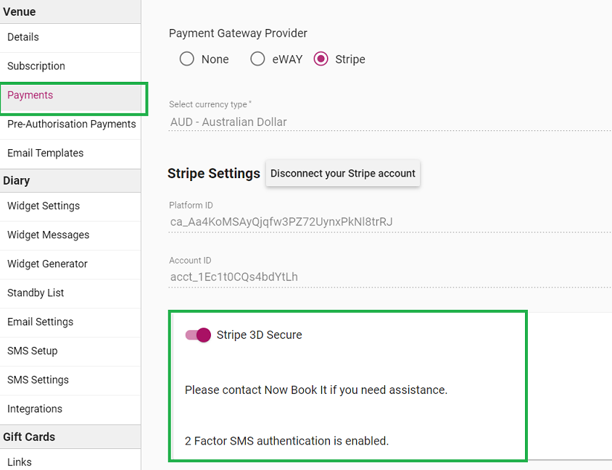
Go to the Payments Tab in the admin Page.
Turn on “STRIPE 3D Secure” at the bottom of the page.
Save.

Slide 3
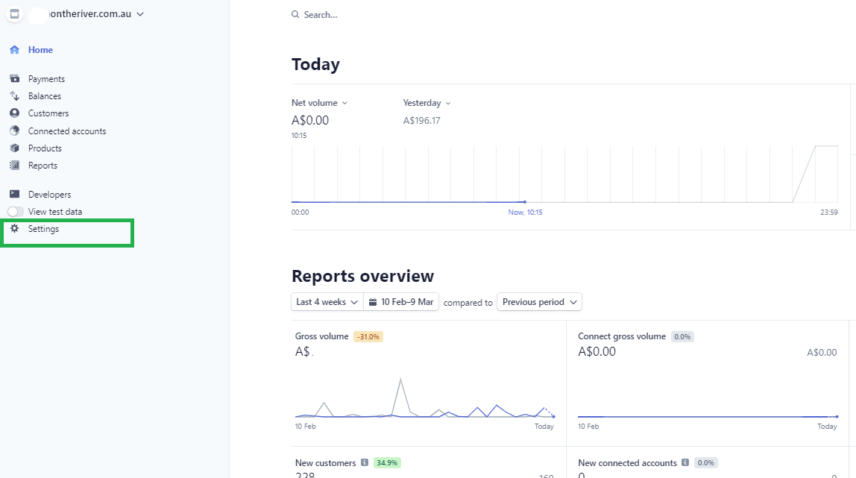
Log into the venues https://stripe.com
Select the “Settings” tab.

Slide 4
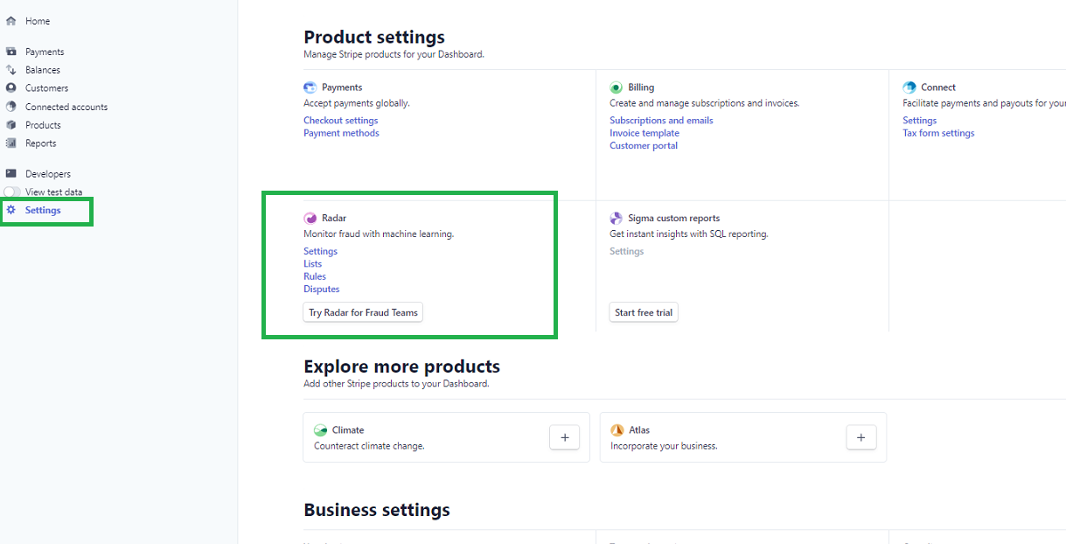
Under the “Settings” Option – you will see an option for “Radar.”
Click “Settings” under the Radar option.

Slide 5
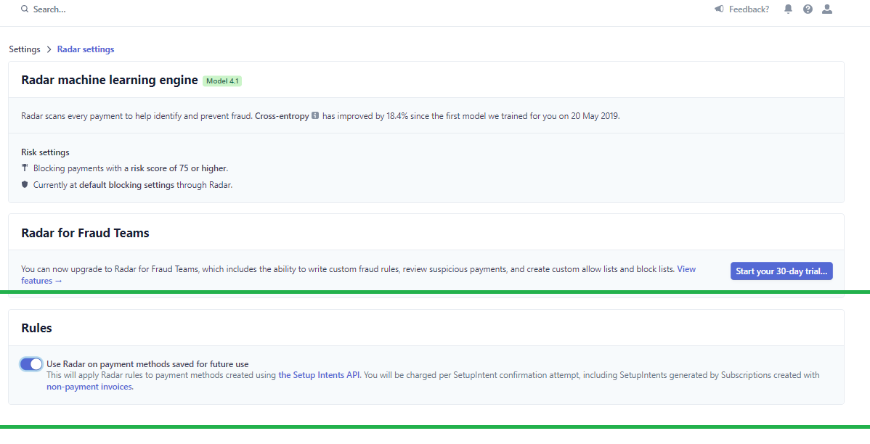
Under Radar Settings.
Turn on “Use Radar On Payment Methods Saved For Future Use.”

Slide 6
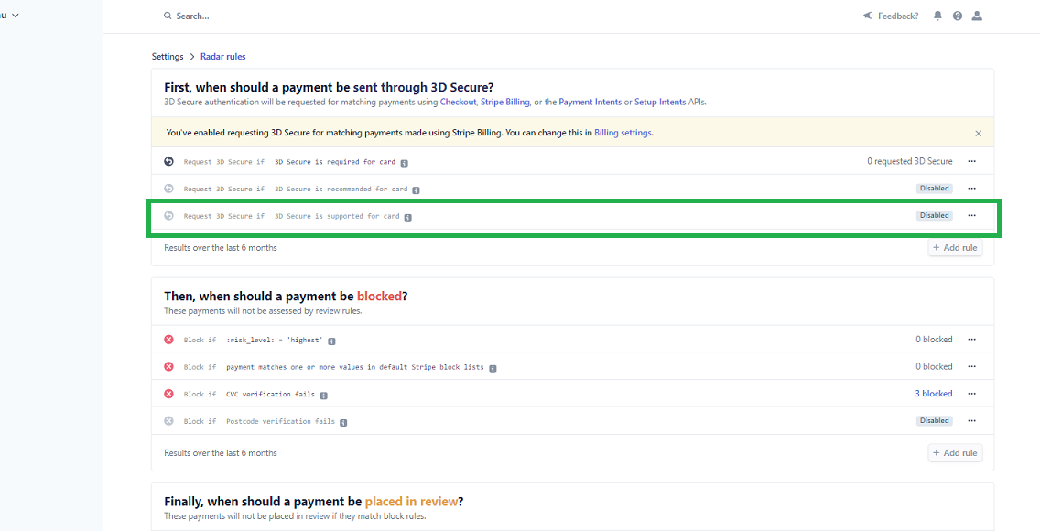
From the last step – go back to “Settings.
Under Radar click into “Rules”
Third Option down will be “Request 3D Secure if 3D Secure is supported for Card.”

Slide 7
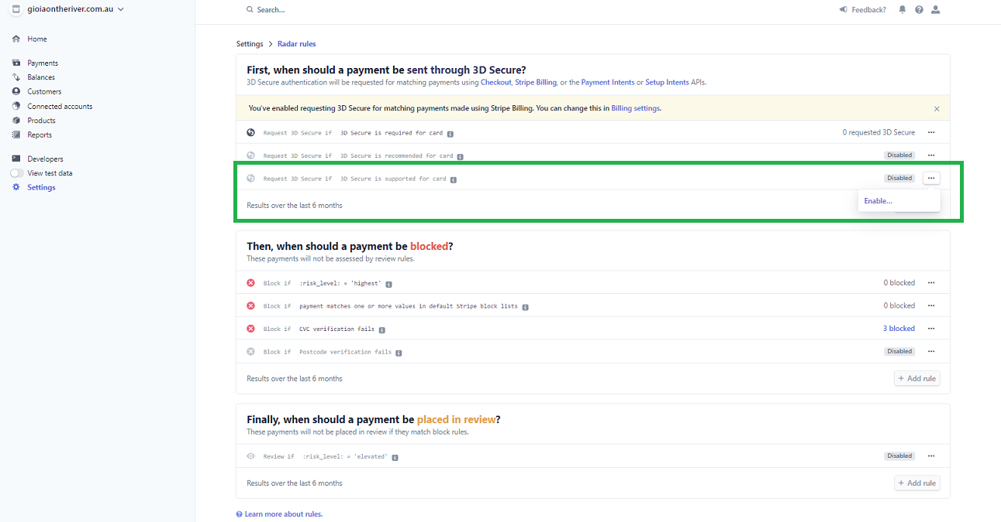
Click the 3 dots next to the word “Disabled.”
The “Enable” option will appear. Select this.

Slide 8
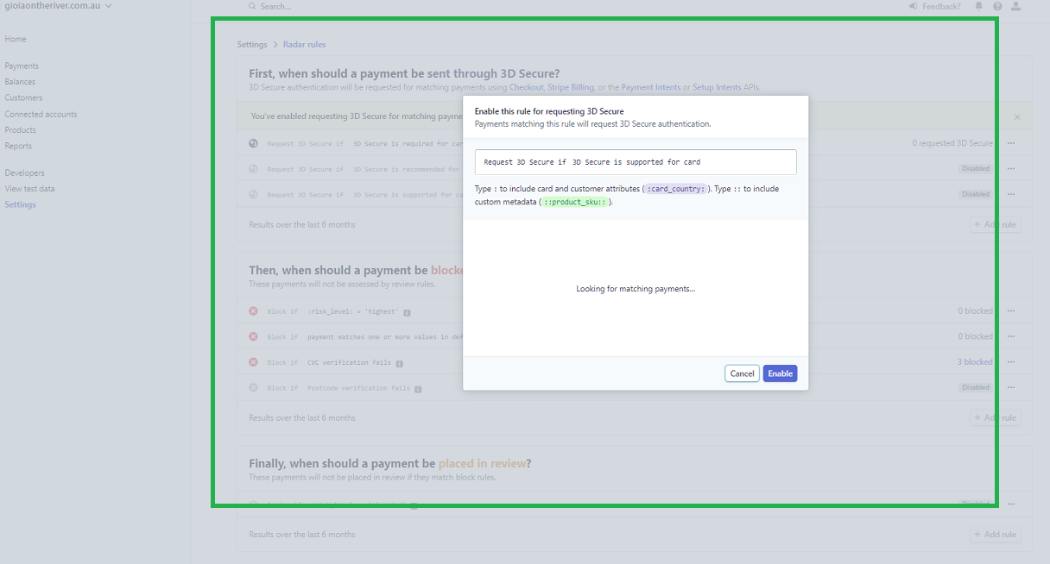
The above Box will appear.
The Customer does not have to do anything other than click “Enable.

Slide 9
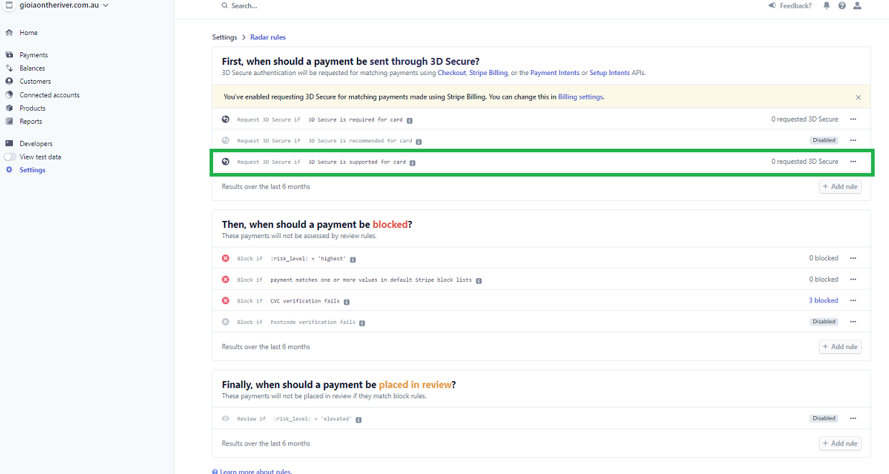
Once you click “Enable” on the previous step, it will bring you back to “Radar Rules.”
You will see under the “Request 3D Secure if 3D Secure is supported for Card” had had Disabled removed. I will have how many requests have come in (should be 0 as you turned it on.) and 3D Secure is displayed.

Slide 10
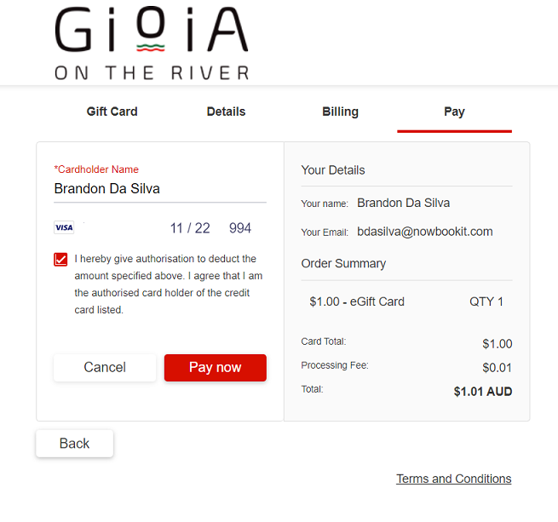
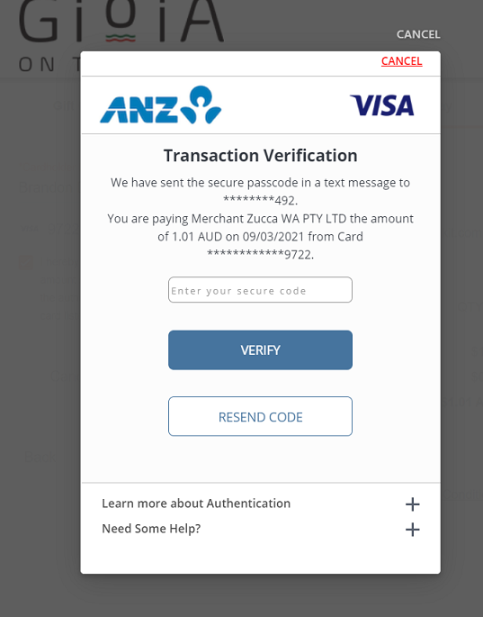
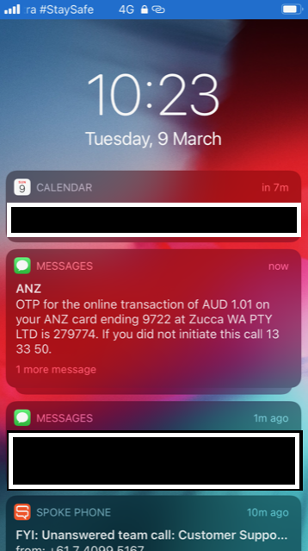
Once the customer goes to the widget, they enter the credit card as usual.
3D Secure activates when they click the “Pay Now” option.
Once “Pay Now” is clicked, the above screen will appear.
The customer will be texted a code, to the mobile number registered to the Credit Card.
Customer will receive a text (like the one above).
Enter the code, and click “Verify.” This will close the transaction if successful.

